Slide 1
Data structure and Instructions to rerun pipelines
Changlin Ke

Slide 2
Requirements:
Python latest ver.:
Pandas, numpy, scipy, matplotlib, seaborn, anndata, scanpy, scikit-learn, scikit-survival, tqdm, cycler, imblearn, scikit-bio, sccoda, statsmodels
R >4.0, installation using anaconda is preferred
Project files location: /home/cke/ in apollo

Slide 3
How to connect from VIEW to Zeus/apollo?
ssh -L 8991:localhost:8892 cke@zeus
ssh -L 8892:localhost:8891 -p22010 cke@localhost
or portfor 8892 8891
conda activate BLADE
jupyter notebook --port 8891 --no-browser &
or jpt 8891
# User specific aliases and functions added into .bashrc of the jump host
function jpt(){
#fire up a jupyter notebook with a port
jupyter notebook --no-browser --port=$1
}
function portfor(){
#forwart port 1 into 2 and listen to it, connect to apollo
ssh -L $1:localhost:$2 -p22010 cke@localhost
}

Slide 4
File structure
Essential components:
Folders saving results and inputs of the two main tests in deconvolution pipeline:
PseudoBulk
InputToWrapper: signature matrices for BLADE, pseudobulk to be deconvolved
Results: Cell type fractions table of each setup per method, signature matrix generated of each setup to be uploaded to CIBERSORTx
scatterplotRes.ipynb generate scatterplots of cell type fractions real vs estimated per method
Real
Runscripts: scripts to run deconvolution and get TME compostions for each method
Pipeline_Deconv_Run.py: manipulating all wrappers and flow control. To replicate and run deconvolution, only this script is needed to interact with.
Pipeline_Deocnv_Run.ipynb: for testing and debugging in each component.
Pipeline_evaluation.ipynb: calculate and plot performance of each setup
runXXX.py or .r: wrappers for each decon method, debug in runXXX.ipynb

Slide 5
File structure
Essential components:
scRNAseqProcessing_Puram and scRNAseqProcessing_Cillo.ipynb: Preprocessing of two datasets, define markers, output a scanpy anndate object (used in deconvolution pipeline)
scRNAseqProcessing_integration.ipynb: data integration
extractPDF.ipynb: get cellularity and fga from pdfs in Kari’s results
Output: cellularity_table.csv, fga_table.csv
Pipeline_downstream_analysis-Show.ipynb: compositional analysis to differentiate groups
DataManip.ipynb: preprocess TCGA data, get malignancy info from Puram files, prepare signature for BLADE, correlation of preliminary results, others deprecated.
Survival_analysis.ipynb: survival analysis to generate fig8 and fig9 in report

Slide 6
File sctructure
Less important part:
Figures
CIBERSORTx: showing an example run of CIBERSORTx
Archive: backup of deprecated scripts

Slide 7
Running deconvolution
Example code running a pseudobulk test:
# nohup python "/home/cke/runscripts/Pipeline_Deconv_Run.py" "/home/cke/Puram/Puram_scanpy.h5ad" "pseudobulk" "/home/cke/PseudoBulk/InputToWrapper/" "/home/cke/PseudoBulk/Results/" "/home/cke/Puram/scRNAlabels/"
--name "fullpipeline_Jul29_noFS“ >out.log 2>&1 &
Example code running a real test:
# nohup python "/home/cke/runscripts/Pipeline_Deconv_Run.py"
"/home/cke/Puram/Puram_scanpy.h5ad" "Real"
"/home/cke/Real/InputToWrapper/" "/home/cke/Real/TCGAResults/" "/home/cke/Puram/scRNAlabels/"
--name "fullpipeline_Aug1_noFS“ >out.log 2>&1 &

Slide 8
Running deconvolution
Arguments for Pipeline_Decon_run.py:
'path_adata', help='directory of preprocessed raw scRNA anndata object'
'mode', help='scheme for data processing', choices=['pseudobulk','real']
'out', help='output CV input directory'
'out_res', help='output of decon methods directory'
'path_label', help='labels of single-cell type identity directory'
path_bulk', help='bulk rnaseq data directory',default=False
Alternative arguments:
'--folder_marker', help='the folder where markers is stored',default=False
‘--name', help='give this job a name to help remember',default='unnamed_job'
'--methods', help='which methods you want to use',default=['MuSiC','BP','BLADE']
'--keyword', help='keyword in marker file name to identify them',default=["top","marker","DEG"]

Slide 9
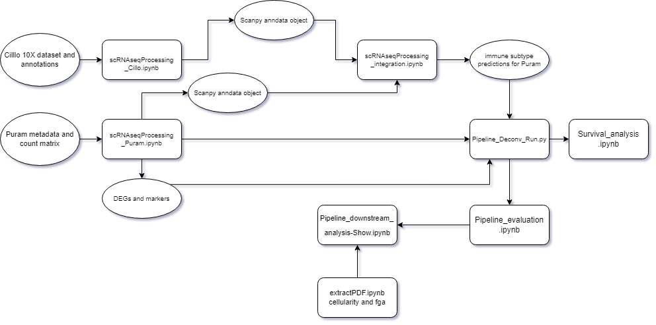
Workflow for replication

Slide 10
Important inputs
scRNA-seq data:
Cillo (processed scanpy objects and original 10X samples from GEO): /home/cke/Cillo/
Puram scanpy object and count matrix after DataManip.ipynb: "/home/cke/Puram/HNSCC2PuramGSE103322_HNSCC_exp_TPM_symbol.tsv"
DEG and self-defined Markers for Puram: "/home/cke/Puram/markers/
Labels for major and immune subtypes: /home/cke/Puram/scRNAlabels/
Bulk RNA-seq data: "/home/cke/TCGA-HNSC.htseq_counts_exp2_symbol_samplexgene.tsv“
Nulton et al. Annotation on HPV status: "/home/cke/Nulton 2017 - supplementary.xlsx“
Clinical and phenotypic data: "/home/cke/TCGA_HNSCC_clinical_data.tsv“ "/home/cke/TCGA-HNSC.GDC_phenotype.tsv"

Slide 11
Useful resource
Reference of a scanpy scRNA project:
Exercises - scRNAseq course (nbisweden.github.io)

